Slide 1
Algorithms
by
Bijoy Rahman Arif
MS, University of Nebraska at Omaha

Slide 2
Lecture 3
Lessons to be learned:
Asymptotic notation
O-notation
Ω-noation
o-notation
ω-notation
Θ-notation

Slide 3
Asymptotic notation
Asymptotic notation gives ideas about growth of function of space and time complexity.

Slide 4
O-notation
O(g(n)) = {f (n) : there exist positive constants c and n0 such that 0 ≤ f (n) ≤ cg(n) for all n ≥ n0}.
It actually gives a upper bound within a constant factor.

Slide 5
O-notation
Lets assume: f(n) = 2n + 3 and G(n) = cg(n) = 3n
f'(n) = 2 < 3 < G'(n) for n >= 0
and f(3) <= G(3)
hence, f(n) <= G(n) = cg(n) for n >= 3 and c = 3
so f(n) = 2n + 3 = O(g(n)) = O(n) for n >= 3 and c = 3.
Like this way, 2n + 3 = O(n) = O(n^2) = O(n^3)
for sufficiently large value of n and c.

Slide 6
Ω-notation
Ω(g(n)) = {f (n) : there exist positive constants c and n0 such that 0 ≤ cg(n) ≤ f (n) for all n ≥ n0}.
It actually gives a lower bound within a constant factor.

Slide 7
Ω-notation
Lets assume: G(n) = cg(n) = 2n and f(n) = 3n + 2
G'(n) = 2 < 3 = f'(n) for n >= 0
and G(0) <= f(0)
hence, G(n) = cg(n) <= f(n) for n >= 0 and c = 2
so f(n) = 3n + 2 = Ω(g(n)) = Ω(n) for n >= 3 and c = 2.

Slide 8
o-notation
o(g(n)) = {f (n) : for any positive constant c > 0, there exists a constant n0 > 0 such that 0 ≤ f(n) < cg(n) for all n ≥n0}.
It actually gives non tighter upper bounds.

Slide 9
o-notation
f(n) = 2n + 3 = O(n) for n >= 3 and c = 3 it fulfills the criteria but f(n) != o(n) because for c = 1 it fails the criteria.
But f(n) = o(n^2) any value of c and for sufficiently large n.

Slide 10
ω-notation
ω(g(n)) = {f (n) : for any positive constant c > 0, there exists a constant n0 > 0 such that 0 ≤ cg(n) < f (n) for all n ≥ n0}.
It actually gives non tighter lower bounds.

Slide 11
ω-notation
f(n) = 2n^2 + 3 = Ω(n^2) for n >= 0 and c = 1 it fulfills the criteria but f(n) != ω(n) because for c = 3 and n >= 2 it fails the criteria.
But f(n) = o(n) any value of c and for sufficiently large n.

Slide 12
θ-notation
θ(g(n))={f (n) : there exist positive constants c1, c2, andn0 such that 0≤c1g(n) ≤ f (n)≤c2g(n) for all n ≥n0}.
It actually bounds the function from upper and lower side within a constant factor.

Slide 13
A useful Theorem
If f(n) = O(g(n)) and f(n) = Ω(g(n)) then f(n) = Θ(n).
Proof:
(i) if f(n) = O(g(n)), then f(n) <= c2g(n)
(ii) if f(n) = Ω(g(n)), then f(n) >= c1g(n)
yield f(n) = Θ(n) for sufficiently large n, some choice of c1 and c2.

Slide 14
Θ-notation
Proof that f(n) = 2n + 3 = Θ(n).
Proof:
We assume: f(n) = Θ(n) then
c1n <= f(n) <= c2n then
c1n <= 2n + 3 <= c2n
c1 <= 2 + 3/n <= c2
it is indeed true for c1 = 2, c2 = 3 and n >= 3
QED

Slide 15
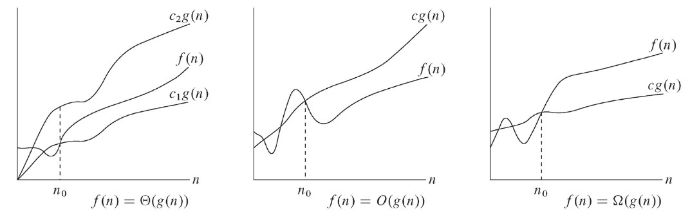
Comparison of O, Ω, Θ-notations

Slide 16
Questions??

